Slide 1




LF Logistics – ETA Prediction
Department of Industrial Engineering and Decision Analytics
Final Year Project
Supervisor: Prof. Wei YOU
Group Members: TSANG Yu, CHAN Kwan Kiu, LIN Xintong

Slide 2
CONTENTS
01
02
03
Introduction
Problem Identification
Objectives
05
06
Results
Conclusion
04
Methodology

Slide 3
01
Introduction

Slide 4




Li & Fung Logistics is a company that primarily provides B2B logistics services in Asian countries
Foundation
Customers
Found in 1906 by Li To-ming & Fung Pak-liu
Headquarter: Hong Kong
B2B
Industry like apparel, footwear, toys, electronics, and home goods, etc.
Distributors
Retailers
Manufacturers
Services
Logistics business
Supply chain solutions
Focused markets
Hong Kong
Mainland China
Taiwan
Singapore
Thailand
Philippines
Indonesia
Malaysia
Notes:
Li & Fung creates customized, end-to-end supply chain and logistics solutions for brands and retailers worldwide. The Services segment consists of the supply chain solutions and logistics businesses.
Mainly focus on Asian market
apparel, footwear, toys, electronics, and home goods,

Slide 5
ETA is an important factor for logistics companies to monitor and manage shipment
Estimated Time of Arrival (ETA)
Importance of ETA
ETA refers to the estimated time
at which a shipment or delivery
is expected to arrive at its destination
It is based on many factors:
Distance between the origin and destination
The mode of transportation (vehicle)
The route taken
Any potential delays or disruptions along the way
For logistics firms:
Enhance customers’ satisfaction and loyalty
Utilize the vehicles by shipment planning
Improve workforce management
Detect any procedural or system concerns that may impact the delivery process
Notes:
It allows all parties involved to plan effectively because the sender may provide a realistic time frame for the arrival of a cargo or person, allowing the receiver to plan their calendar accordingly. ETA can help detect any procedural or system concerns that may impact the delivery process and provide clarity.

Slide 6
02
Problem Identification

Slide 7
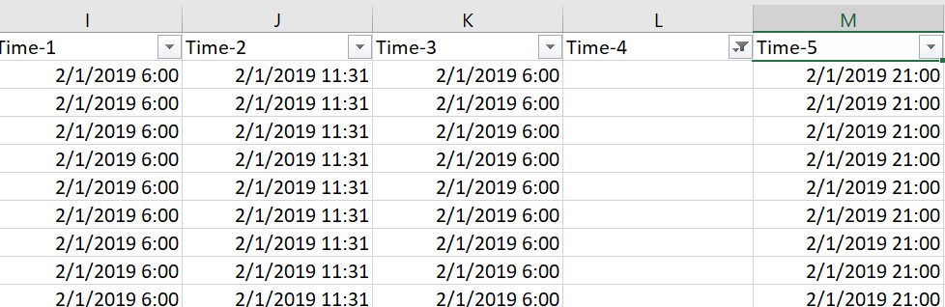
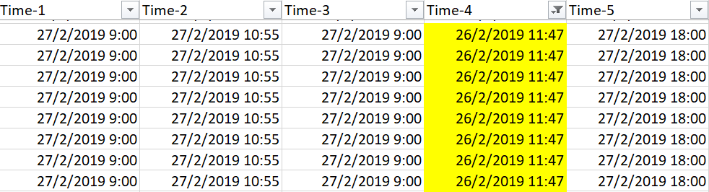
Problems in dataset and ETA prediction model
Poor data quality
Plan Start
Plan End
Actual Start
Actual End
Auto Fill
Uncomplete data with plenty of missing values
Inaccurate data (e.g. shipment ending time)
Poor ETA quality
5%
data left after filtering

Slide 8
Problems in dataset and ETA prediction model
Poor data quality
Limited features for ETA prediction
Inconsistent system for regions
Interview → DID NOT consider environmental factors into ETA prediction
Interview → DID NOT have an integrated system to predict and view all regions
Uncomplete data with plenty of missing values
Inaccurate data (e.g. shipment ending time)
Poor ETA quality
Less accurate ETA results
Inefficient and costly

Slide 9
03
Objectives

Slide 10
1. Improve data quality with new data processing algorithms
2. Consider new features and different models to enhance accuracy of ETA
3. Integrate ETA prediction and visualization system for different regions

Slide 11
04
Methodology

Slide 12
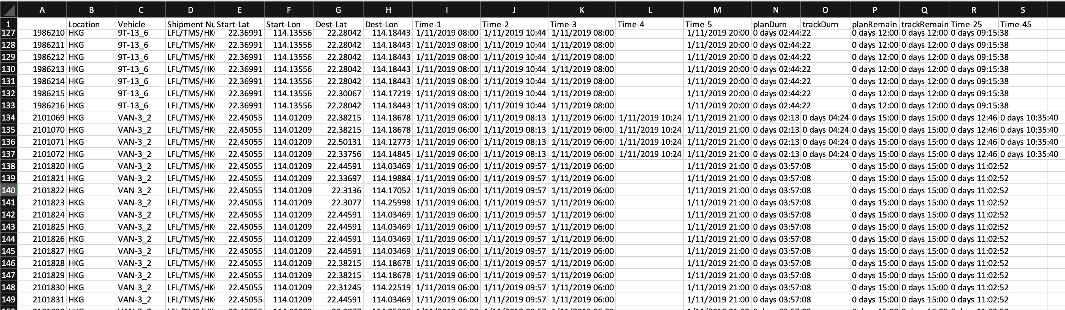
Observation
Identifying logic: Same [‘Vehicle’, ‘Location’, ‘Start-Lat’, ‘Start-Lon’, ‘Time-1’(planStartTime), ‘Time-3’(actualStartTime)]

Slide 13
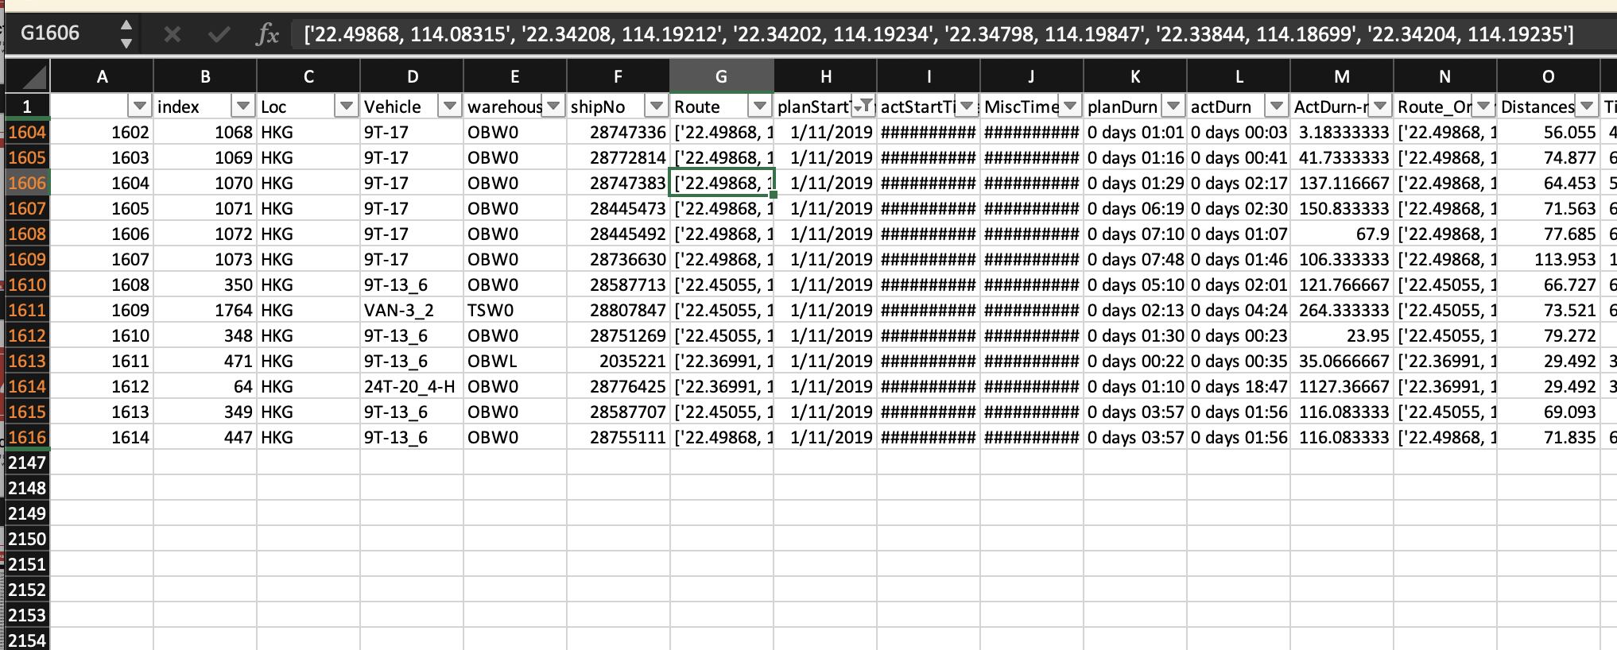
Drop Null Values and Creating Routes

Slide 14
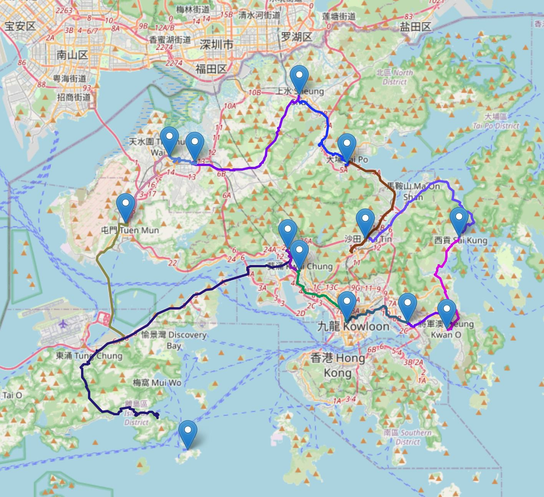





Calculation of ETA
Calculation
Cleaning and Modeling
*Free-tier
enough
Assume K = T0/T1 and K∈[0.3, 10]
OpenStreetMap
Loading & Unloading Buffer
Weekday/ Weekend Coefficient
Rush / Non-rush hour Coefficient
Map Data
Traffic Data
Slice Map to feed tomtom
traffic data(speed)
After many trails
HK Graph with Traffic Data
Random Forest
XGBoost
Weather Data
TSP
This Iteration
Training
Predict
Current Date
Cross-Validation
Included
(cv=5, n_iter=50)
Ortool
Routing
Dataframe
Dataframe
Route Time from
OSM(T1)
Day 0 | Day 1 | Day 2 | Day 3 | Day 4 | Day 5 | Day 6 | Day 7 | Day 8 | Day 9
Actual Time(T0)
OpenStreetMap
Next Iteration
Training
Current Date

Slide 15
Calculation of ETA
Calculation
Cleaning and Modeling
*Free-tier
enough
Assume K = T0/T1 and K∈[0.3, 10]
OpenStreetMap
Loading & Unloading Buffer
Weekday/ Weekend Coefficient
Rush / Non-rush hour Coefficient
Map Data
Traffic Data
Slice Map to feed tomtom
traffic data(speed)
After many trails
HK Graph with Traffic Data
Random Forest
XGBoost
Weather Data
TSP
This Iteration
Training
Predict
Current Date
Cross-Validation
Included
(cv=5, n_iter=50)
Ortool
Routing
Dataframe
Dataframe
Route Time from
OSM(T1)
Day 0 | Day 1 | Day 2 | Day 3 | Day 4 | Day 5 | Day 6 | Day 7 | Day 8 | Day 9
Actual Time(T0)
OpenStreetMap
Next Iteration
Training
Current Date

Slide 16
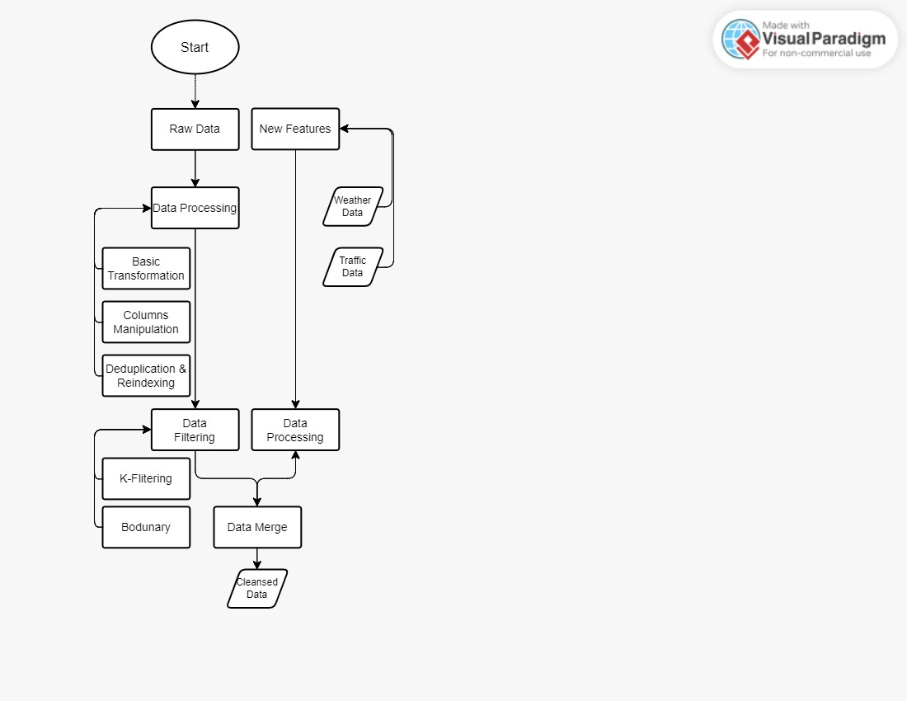
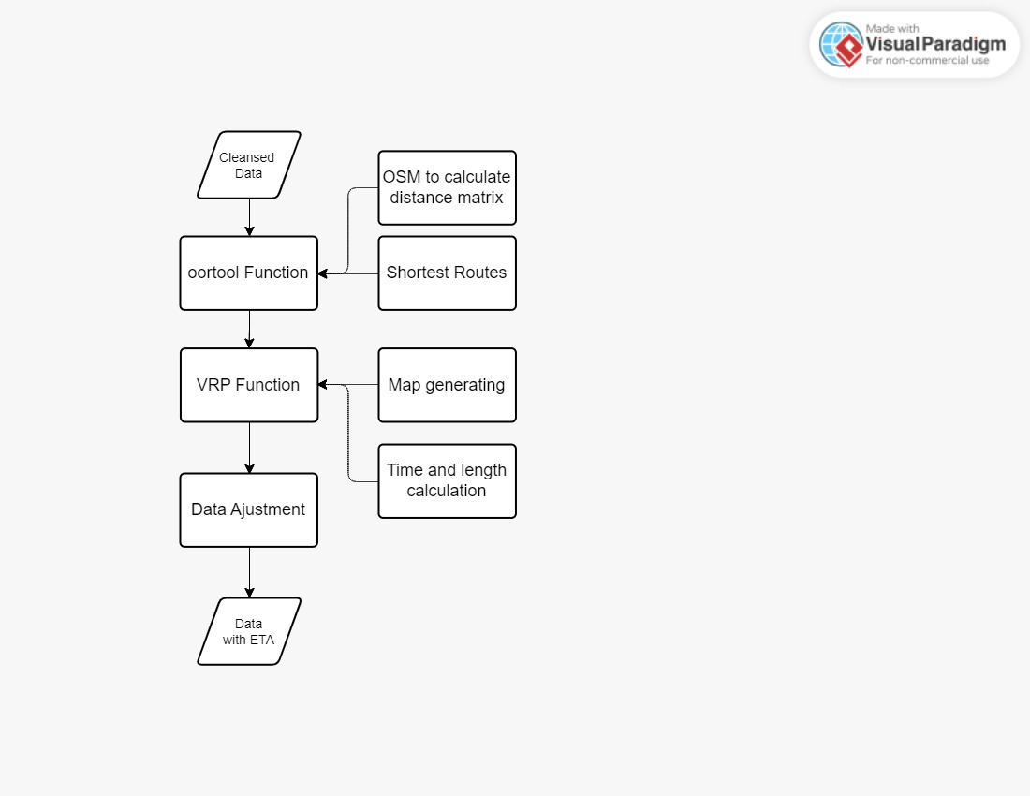
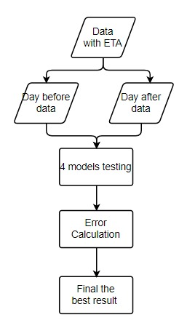

Slide 17
05
Results

Slide 18
ETA Performance
Solving the VRP (Vehicle Routing Problem)
Find the best route possible for each shipment
Evaluation
Benefits to stakeholders
MAE (Mean Absolute Error)
MAPE (Mean Absolute Percentage Error)
Accuracy of predictions against actual arrival times
Facilitate route planning and travel time estimation
Help driver make quick decision over which route to select when leaving a warehouse
RF – MAE: 49.35 (mins) MAPE: 37.99 %
XGBOOST - MAE: 41.1(mins) MAPE: 32.98 %

Slide 19
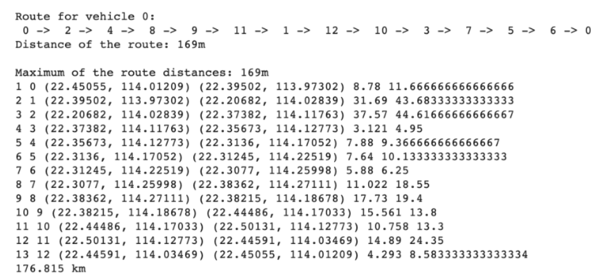
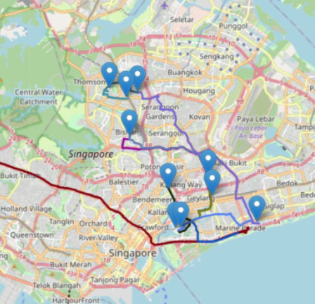
Dashboard Visualization - Creation and Advantage
Optimal route sequence were generated
(Locations in longitude and latitude format)
Transform the results to
routes embed on roadmap using the
VRP helper function and Folium
Saving as “map.html” for the dashboard
Advantage of using dashboard
Provide visual elements: grasp the overall patterns of each shipment
Set personalize view: focus on specific metrics of interest
Serve as a centralized platform: dispatchers, managers, drivers stay informed and coordinate
Notes:
Data Visualization:
Dashboards present ETA results in a visually appealing and easy-to-understand format. Through charts, graphs, maps, and other visual elements, users can quickly grasp the overall patterns, trends, and distribution of arrival times across different locations or routes.
Customization and Filters:
Dashboards typically offer customization options, allowing users to personalize the view and focus on specific metrics or regions of interest. Filters can be applied to isolate specific routes, drivers, or time periods, enabling users to drill down into specific details as needed.
Collaboration and Communication: Dashboards provide a centralized platform for teams to collaborate and share information. Stakeholders, such as dispatchers, managers, and drivers, can access the same dashboard to stay informed, coordinate efforts, and communicate effectively.
'VRP (graph, solution _list)':
'VRP': The 'VRP' function takes a list of strings representing the coordinates of delivery
locations and the depot as input. It returns a folium map object, the total route length, and the
total route time. The function calculates the shortest route between each pair of consecutive
nodes in the solution list using the 'shortestRoute' function. It then plots the resulting routes on
the folium map object using the 'ox.plot _route_folium' function. The function also calculates the
total route length and time by calling the 'routeLength' and 'route Time' functions. Finally, the
function returns the folium map object, the total route length, and the total route time as output.

Slide 20
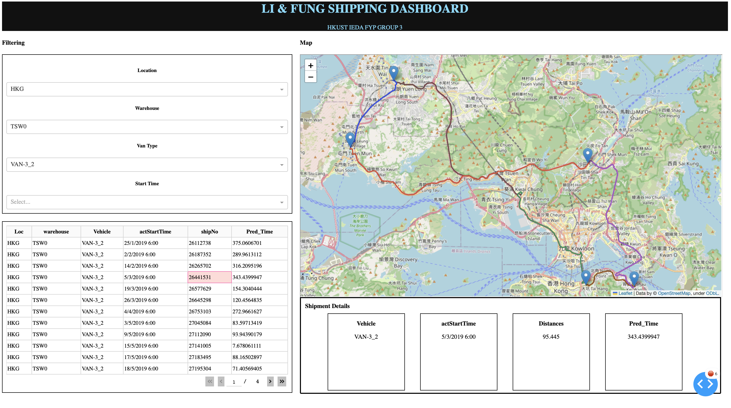
Dashboard Visualization - Demonstration
Key Features
Filtering functionality
(single or multiple)
Options on top
Shown calculated optimal routes
Key Shipment details of selected shipment
Filter + Select
Notes:
Map Creation:
Folium provides a Map class that allows you to create a basic map.
You can specify the initial center location, zoom level, tileset, and other options.
The map can be displayed as an interactive HTML output within Jupyter notebooks or saved as an HTML file.

Slide 21
06
Conclusion
Notes:
Possible Improvement & Recommendations
Summary

Slide 22
Future Improvement
Regarding Initial Poor Raw Data Quality
Implementing automated data collection tools:
Reduce human input error of data
Using RFID or GPS devices that automatically record data points
More accurate raw dataset
Implementing standardized data collection procedure for all areas:
Consistent collection and recording procedures
Store data in a good manner
Considering more features:
Incident reports ( e.g. real-time traffic conditions accidents or road closure)
Regarding Inconsistency over regions
Regarding Accuracy of ETA results
Addressing the existing problems and limitations for the updated ETA result

Slide 23
Summary
L&F
Processing
Improvements
B2B logistic service
in Asian Countries
+ Customer satisfaction
+ Workforce management
+System Planning
-Delay & cost
Select & clean data
Consider Traffic and weather conditions
Oortool , VRP Functions
Model Selection, error testing
Implement standard data collection procedures for all regions
Include more factors in prediction process etc.
ETA
Data Quality
Issue
Improve the accuracy
Outcomes
Suggestions
Missing and Inaccurate data
New ETA
Optimal Routes
Due to collection process and non-standardized data storage system on each shipment and for different regions
Facilitate decision planning
Enhance communication and accessibility of results

Slide 24
Thank You !

Slide 25
Text roboto font size
Select Outline of presentation
Introduction (2 mins) a. Background of LF Logistics (地點, business, ) b. What is ETA and why important
Problem identification (2 mins provied data --> few features + inconsistent 5% of data left if deleting all row with Null loc, warehouse, vehicle, time only --> inconsistent for diff regions region
Objectives (1 mins) Improve accuracy of ETA
Methodology (6 mins) a. Big map b. In-depth explanations of each part c. Data processing (sorting) d. Time calculation (shortest routes) d. Model training (cross validation)
Results (4 mins) a. ETA with error performance 1) how ETA 2） error (what kind of model is the best, the error for each model) b. Dashboard ( Road map -→VRP ,how to build, demo )
Conclusion (2 mins) a. Summary b. Improvement: limitation of existing data, e.g. data quality c. Recommendation to LF (standard data collection procedure for all regions, )

